Slide 1
TFMM 2017
Addressing the nitrogen pollution quantification challenge with measurement
MM Twigg, M Coyle, D Famulari, J Kentisbeer, C Flechard, D Fowler, I Simmons, S Leeson, E Nemitz, YS Tang, A Stephens, N Van Dijk, CF Braban + other project partners at Ricardo EE, NPL
CEH Edinburgh, Bush Estate, Penicuik, Midlothian EH26 0QB
NPL, Teddington, UK

Slide 2
Some of the science and policy challenges outlined
NO₂
Examples of flux methods applied at an EMEP site
Wet deposition
Site specific N deposition
Ammonia

Slide 3
Science and policy challenge 1:
Surface oxidised N budget: atmospheric deposition/emission
N₂O₅
Direct emissions
hν+Η₂Ο
ClNO₂
HNO₃
Atmospheric components
HONO
VOC(N)
PM(N)
NO₂
VOC(N)
HONO
NO
HNO₃
Surface
processes
NO₂⁻
NO₃*
NO₂*
NO₃⁻
hν+Η₂Ο
Substrate Processes
Plants, animals, soils, microbes, water, buildings,
hν+Η₂Ο

Slide 4
Science and policy challenge 2: Air quality
a. Understand the short episodic and long term impacts of the chemical components
NH₃
ClNO₂
N₂O₅
HNO₃
PM(N)
NO₂
HONO
VOC(N)
b. Provide evidence to improve model processes

Slide 5
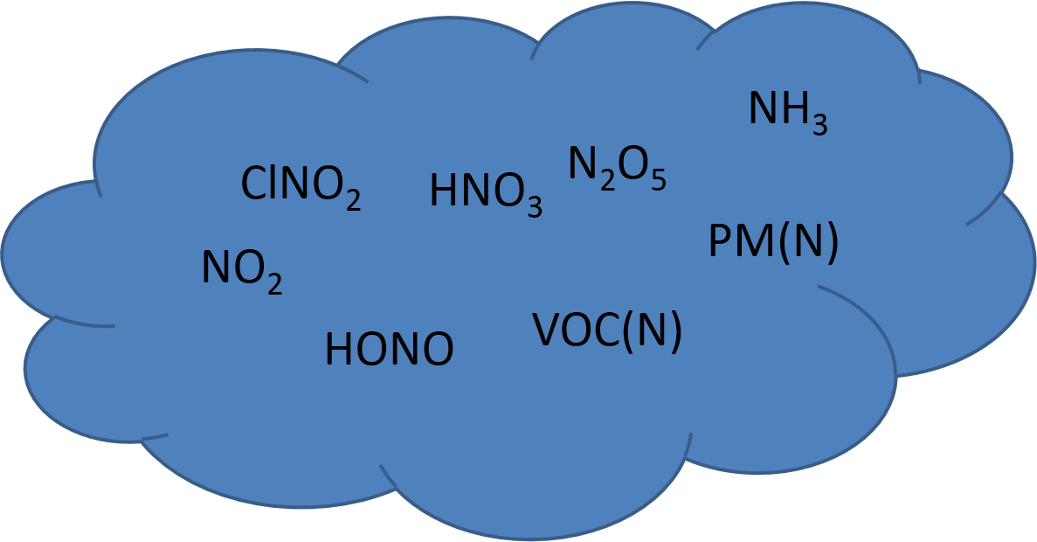
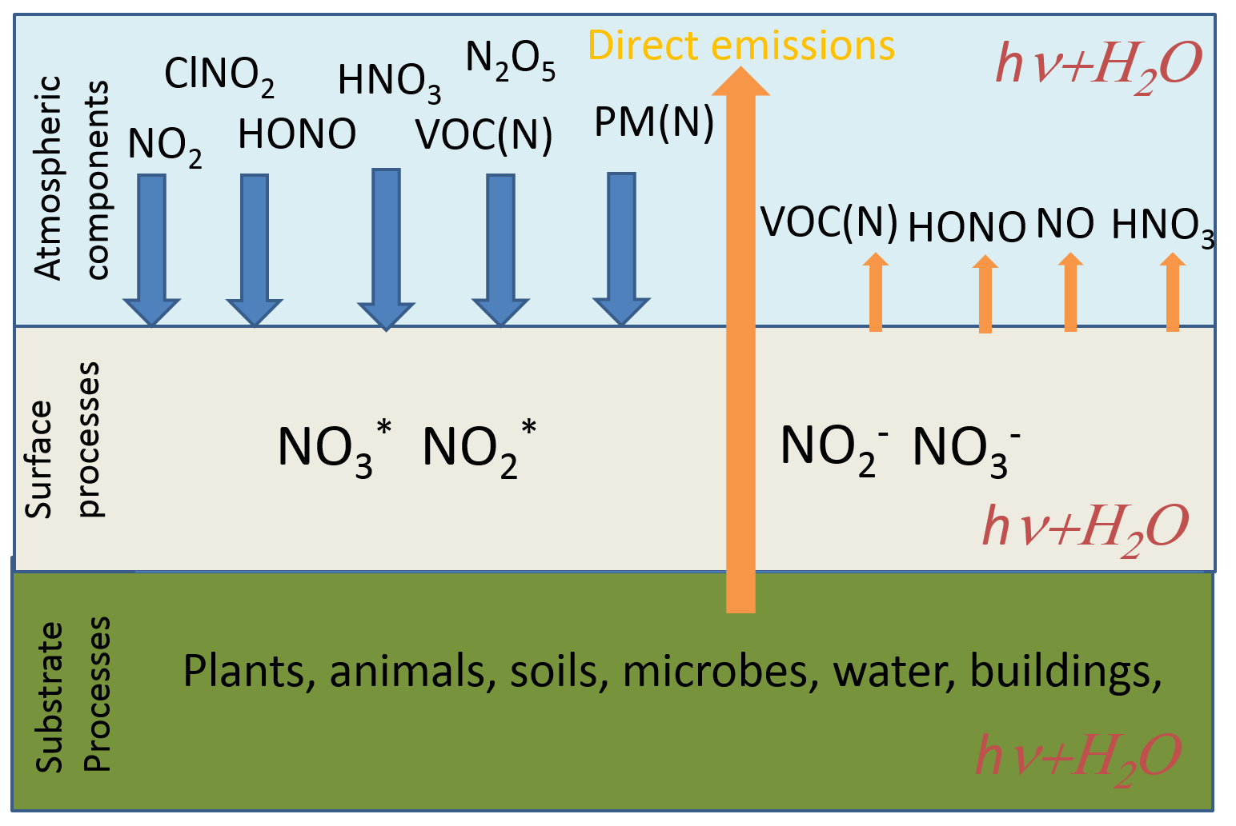
Science and policy challenge 3: Climate
PM
N₂O

Slide 6
Some of the science and policy challenges outlined
The measurement challenges
NO₂
Examples of flux methods applied at an EMEP site
Wet deposition
Site specific N deposition
Ammonia

Slide 7
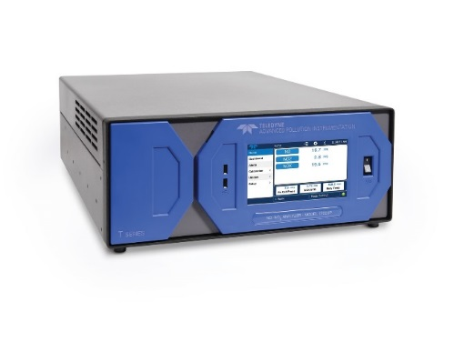
2016 NOx measurements
Up toMay 2015, an Ecophysics ANNOX analyser deployed but suffered repeated system failures
Teledyne T200UP Photolytic Nitrogen Oxide Analyzer system deployed to Auchencorth Moss in January 2016
Data presented is not fully ratified yet

Slide 8
2016 data

Slide 13
Future work
In 2017 chemiluminescence and photolytic instruments will be on same manifold and calibrated at ACTRIS frequency (~3days)
Assess the data in detail: when are large differences occurring, do they coincide with other components measured
Assess regional importance (e.g. for Edinburgh)
In 2017-2019 make campaign based reactive N measurements

Slide 14
Some of the science and policy challenges outlined
NO₂
Examples of flux methods applied at an EMEP site
Wet deposition
Site specific N deposition
Ammonia

Slide 15
Why develop flux systems for reactive N?
Fluxes represent dose to the surface, especially for Critical Loads.
Need for continuous measurements
  seasonal variability in exchange processes
  Spatial variability
Currently extensive concentration networks but estimating the surface flux is often the key objective of the networks
Process studies provide the underpinning parameters for deposition models
  Intensive measurements previously used to obtain this

Slide 16
Micrometeorology: Eddy-Correlation Method
[O₃]
height, z
F(O₃) = w’χ’
w’ instantaneous variation in the vertical component of wind velocity
χ’ instantaneous variation in O₃ concentration
Fast
sensor
Simplest theoretically
Least empirical
Requires fast instrumentation
Expensive
h
d
[O₃] = 0
Notes:
Eddy-correlation method, measure instantaneous variation in the vertical component of wind speed caused by rapidly moving turbulent eddies and the simultaneous variations in trace gas concentration, flux is simple the average product of these variations
Simplest theory and least empirical although in practice some adjustments have to be made to field data
Requires fast instrumentation over short vegetation/crops (>10 Hz sampling) can be expensive for trace gases

Slide 17
Micrometeorology: Aerodynamic Gradient Method
[O₃]
F(O₃) = K_{O3} ∂ χ_{O3}
∂ z
height, z
[O₃]
K_{O3} = diffusion coefficient
χ_{O3} = concentration
τ = K_{m} ∂ u
∂ z
u
T
τ = momentum flux
u = horizontal windspeed
K_{m} = diffusion coefficient
K_{m} ≅ K_{O3}
h
Simple instrumentation
“low-cost”
Indirect method
Empirical relationships are used
d
[O₃] = 0
1 ms⁻¹
2 ppb
3ºC
Notes:
Gradient method: Flux is described using Fick’s law, flux = rate of change of entity with distance x diffusion coefficient (eddy diffusivity)
Find K use similarity theory essentially measure windspeed gradient find Kmomentum and so Kgas, also measure temperature to calculate Km and apply corrections.
Simple instrumentation, operates 0.5 - 1 hourly resolution
Requires empirical relationships

Slide 18
Aerodynamic Flux Gradient Method
constant flux layer
REQUIREMENTS:
Fully-forced convection
Homogeneous, flat and uniform surface area (fetch) to investigate
Assessment of atmospheric conditions for stability corrections
fetch:height = 100:1

Slide 19
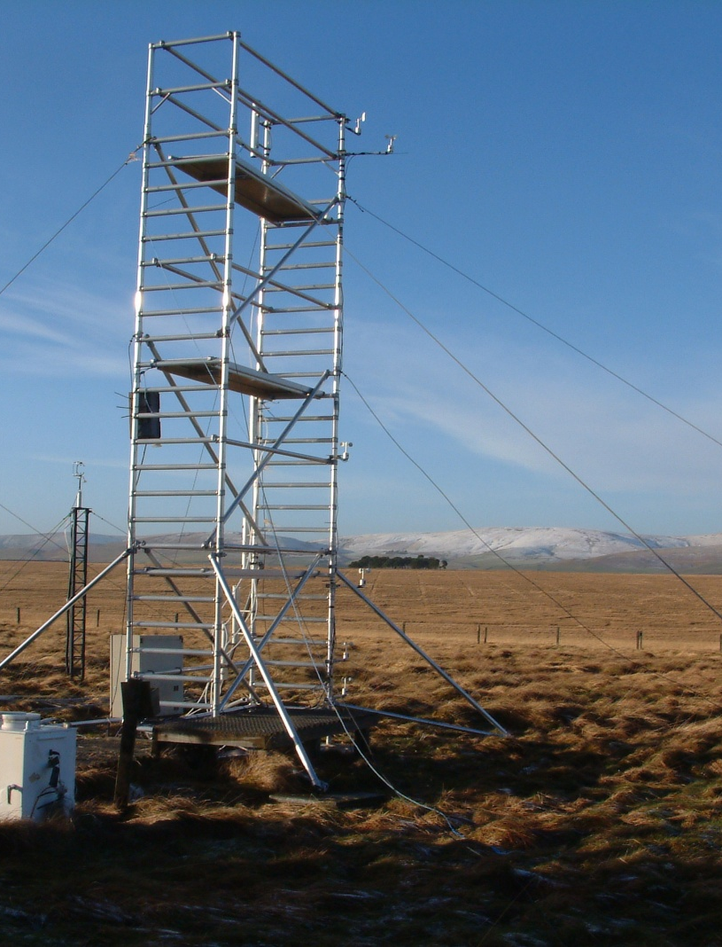
5-Height System at Auchencorth Moss
Notes:
The system has 5 cup anemometers, 5 thermocouples, and 5 denuders all placed at regular logarithmic vertical distances.

Slide 20
The COTAG philosophy
Conditional Time Average Gradient (COTAG) system
For cost-efficient (semi-)continuous flux measurement
  Avoid online sampling techniques
  Reduce number of chemical analyses
Measure time-averaged gradients, coupled to average turbulence and stability correction
  Time average gradient system already successfully applied in the UK (Famulari et al. 2010)
Famulari et al. 2010 Development of a low-cost system for measuring conditional time-averaged gradients of SO2 and NH3 Environmental Monitoring and Assessment, 161. 11-27

Slide 21
Conditional Time Averaged Gradient (COTAG)
NEUTRAL
PUMP
DATALOGGER
RELAY
FILTERS
FOR NH4+, NO3-,Ca, Na, Mg, Cl
NON-NEUTRAL
Data-logger program calculates on line stability parameters and sends power to relay if window of neutrality is fulfilled
DELTA system samples: denuders and filters to sample gases and particles
DENUDERS
FOR NH3
DENUDERS
FOR HNO3, SO2
AIR INLET

Slide 22
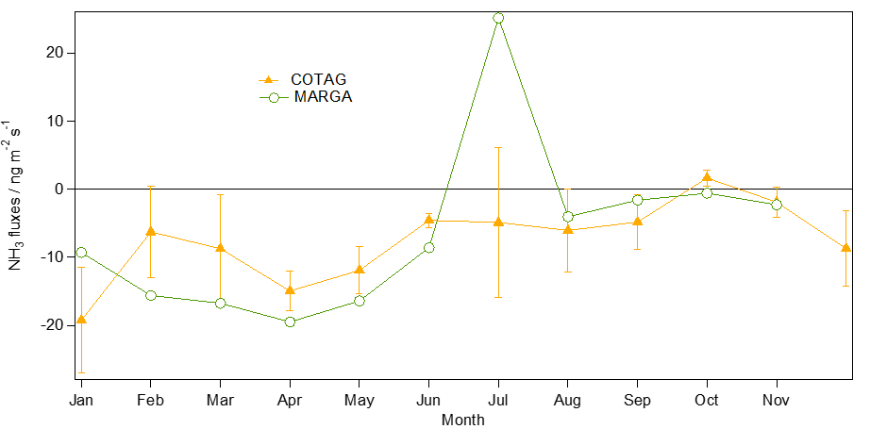
Measured and modelled fluxes (5 point)
MARGA fluxes are calculated using an inferential model and the measured concentrations.

Slide 23
Measured and modelled fluxes (5 point)
Gradient fluxes: 5 point concentration using a Thermo Fisher analyser.

Slide 24
Future potential for fluxes at EMEP sites
Assess which sites also have micrometeorology operating
  Link across to ICOS
Assess potential to do site specific deposition
  Basic requirement for N deposition:
  NH₃
  NO₂
  Daily or higher temporal resolution wet deposition
Other components to consider:
  HNO₃
  HONO
  O₃
  SO₂
  Target component most relevant and easiest to do at site

Slide 25
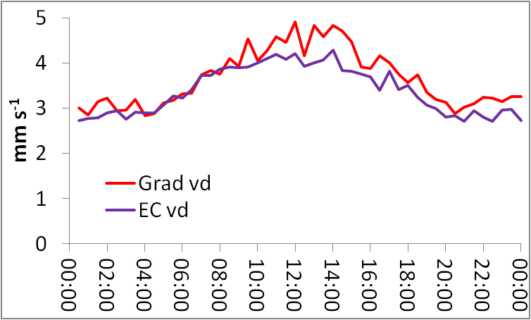
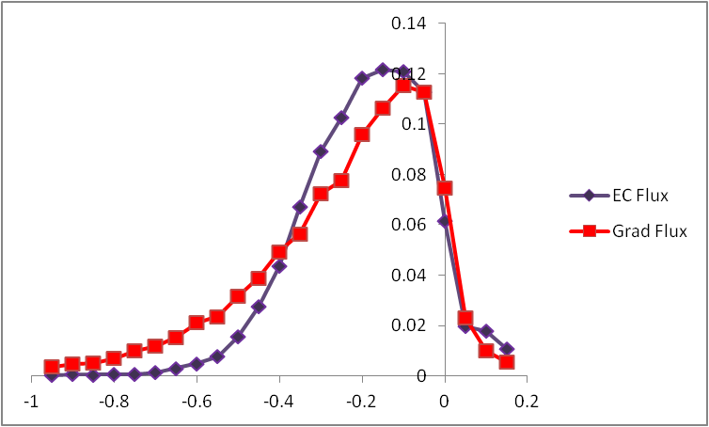
AU – Ozone Deposition Nov 2012 – Aug 2014
EC -195 ng m⁻² s⁻² 3.4 cm s⁻¹
Grad -222 ng m⁻² s⁻¹ 3.6 cm s⁻¹
1995-98 -205 ng m⁻² s⁻¹ 3.6 cm s⁻¹

Slide 26
Some of the science and policy challenges outlined
NO₂
Examples of flux methods applied at an EMEP site
Wet deposition
Site specific N deposition
Ammonia

Slide 27
Harwell and Auchencorth vital statistics

Slide 28
NH₄⁺
Harwell
Auchencorth

Slide 29
NO₃⁻
Harwell
Auchencorth
Opportunity for comparing annual patterns of deposition at sites
New technologies available for on-line precipitation composition should be assessed for Level II/III sites

Slide 30
Some of the science and policy challenges outlined
NO₂
Examples of flux methods applied at an EMEP site
Wet deposition
Site specific N deposition
Ammonia

Slide 31
The ammonia measurement challenge
Aim: quantitative, molecule specific measurements fit to the purpose of the research or policy question
Gas-phase extraction followed by analytical chemical
On-line
Off-line
Direct gas phase measurement
Open path/remote
Closed path/gas sampling
Target data quality?
accuracy: ±5% reference traceable calibrations
Temporal resolution?

Slide 32
Set up key for high temporal resolution
Ammonia
Source
Instrument
Inlet
Notes:
How we plan on testing the inlets at NPL, what we are looking for.

Slide 33
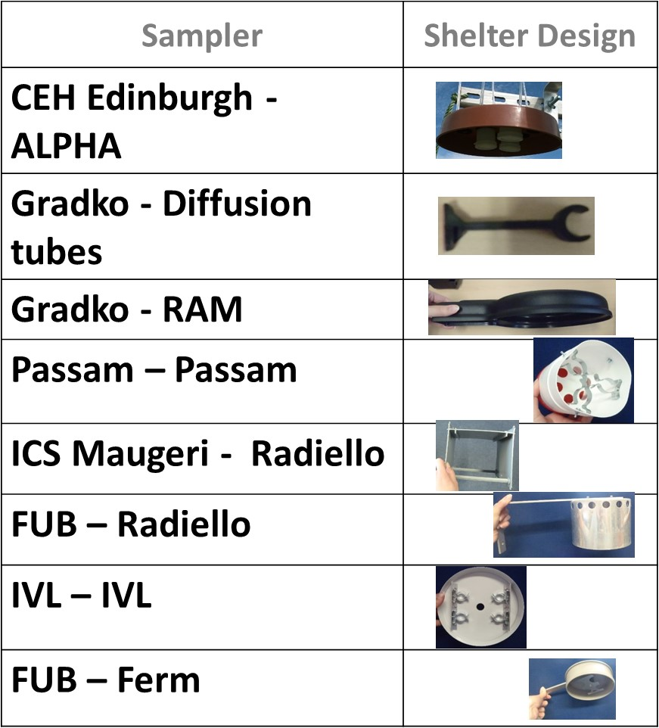
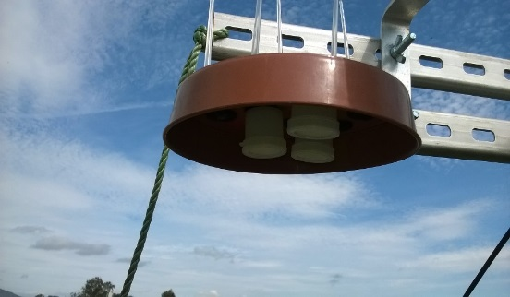

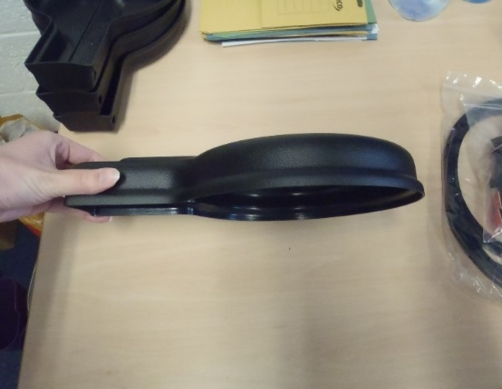
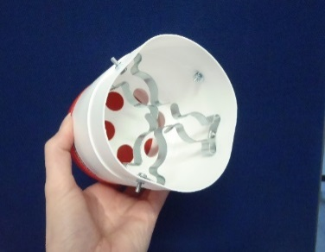
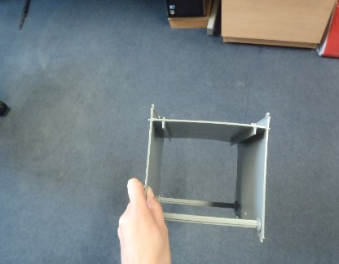
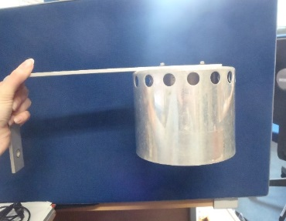
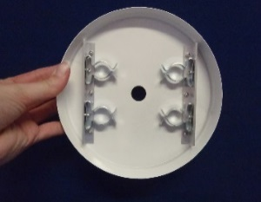
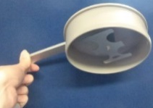
Passive sampler/Denuders: QA
Temperature specific uptake required
Low cost and ideal for seasonal and annual trends of NH₃
Sampler | Shelter Design
CEH Edinburgh - ALPHA
Gradko - Diffusion tubes
Gradko - RAM
Passam – Passam
ICS Maugeri - Radiello
FUB – Radiello
IVL – IVL
FUB – Ferm

Slide 34
Suggested level definitions for EMEP NH₃
 | Temporal resolution | Uncertainty | Method Documentation
Level I | 1 day - 1 month | <30% | CEN standard or ISO or EMEP defined
Level II | Maximum daily | <10% | CEN standard or ISI publication defined
Level III | 10 Hz- Hourly | Better than 5% or RESEARCH level | User provided; Research evidence

